Slide 1

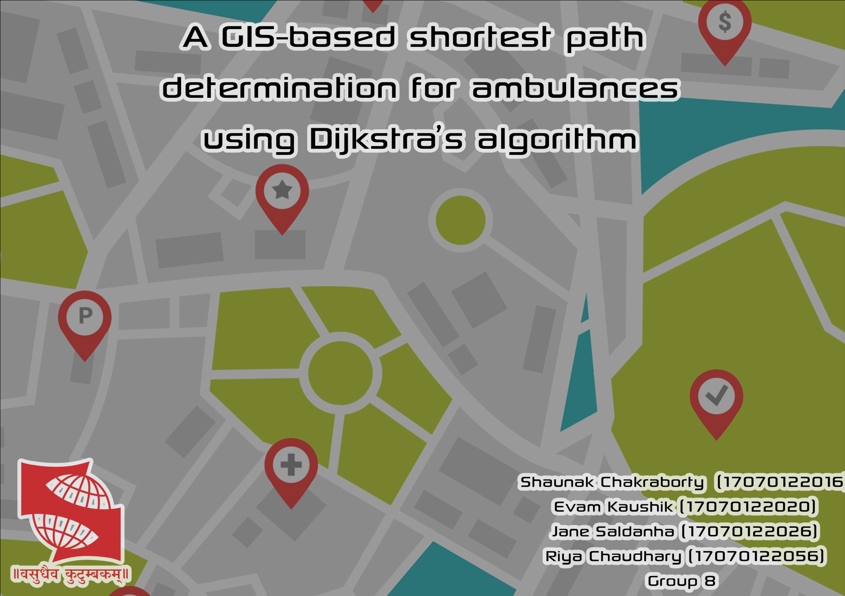

Slide 2
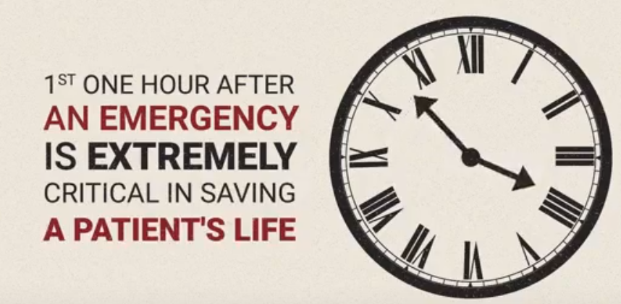
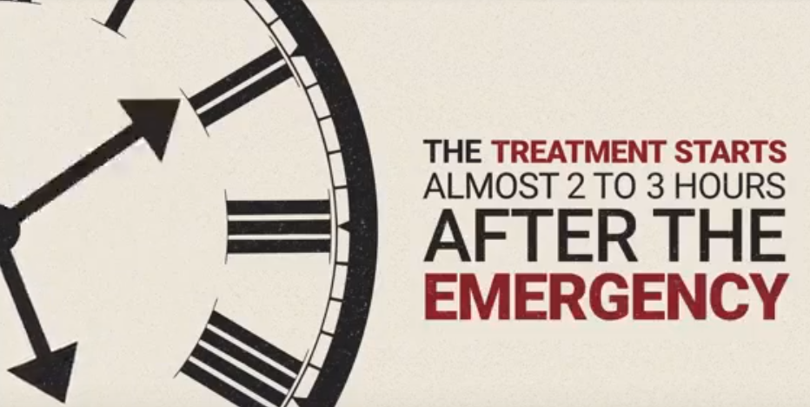
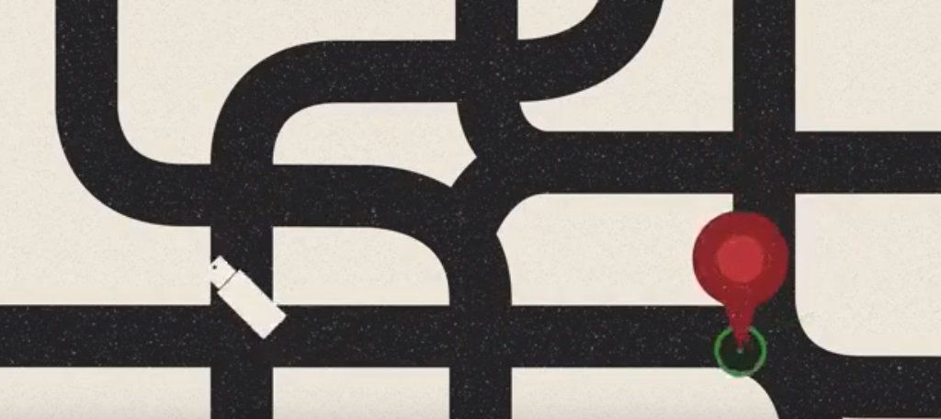
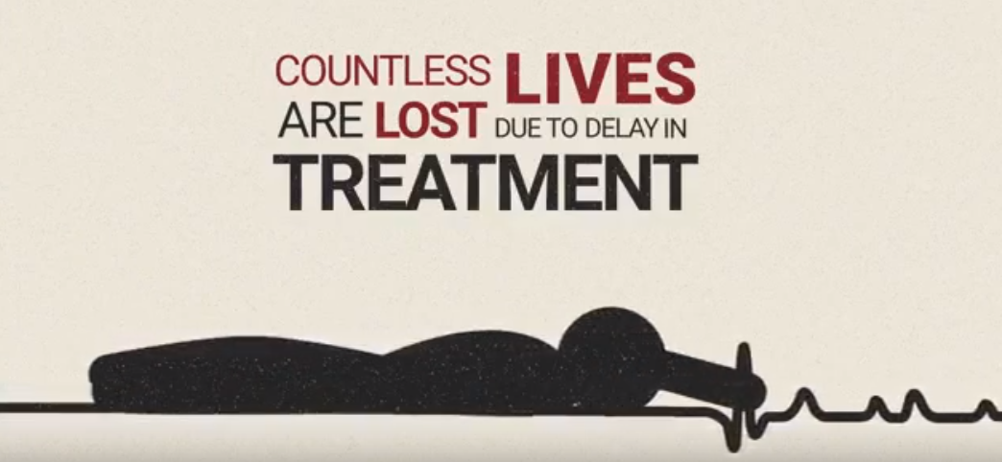

Slide 3
Problem statement
To address the difficulty in identifying the route to the user , design an application for call-centers which can be used by its employees to locate the nearest hospital (shortest distance) to the user.
The application should also display the path from the hospital to the user , which can be utilized by an ambulance to reach the user as quickly as possible.

Slide 4
Solution
User calls the call center when in an emergency situation.
Call center traces user’s location
Application searches nearest hospital(s) by querying the database of hospitals
Compute the path and its length ( in km ) using Dijkstra’s algorithm from hospital to user for all hospital(s) found.
List of Hospitals found is sorted in ascending order of distances from user.
Display the three nearest hospitals ( in case a hospital rejects request ) and the shortest path to end-user.

Slide 5
Case 1 : Multiple Hospitals are found in search radius
H₁
U : User
H : Hospital
5 km
U
H₂
: Path
: Direct distance

Slide 6
Case 2 : No hospitals found in initial search radius
U : User
H : Hospital
H₁
U
5 km
H₂
10 km
: Path
: Direct distance

Slide 7
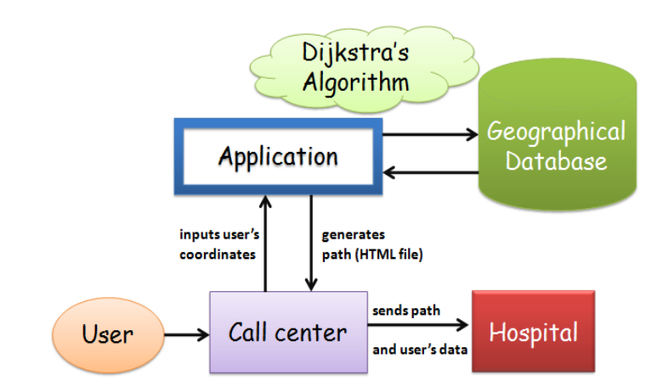
Design

Slide 8
Front end :
Python’s gmplot package
Back end :
Python to parse XML file generated by OSM ( Open Street Maps )
Implementation of Dijkstra’s algorithm in C.

Slide 9
A
1
B
10
9
S
3
2
6
4
2
5
END
D
C
u = D
u = S
u = A
u = B
u = C
2
v = A
v = D
v = B
v = C
v = A
v = B
v = B
V | S | A | B | C | D
dist [V]
π [V]
0
∞
∞
∞
∞
8
11
10
14
13
7
5
S
D
D
D
A
S
NULL
NULL
C
NULL
NULL
NULL

Slide 10
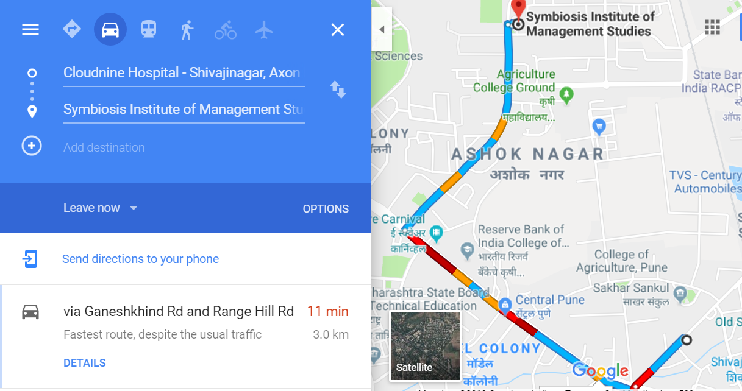
Screenshot of path and distance from Cloud nine Hospital to Symbiosis Institute of Management produced by Google Maps
Cloudnine
Hospital

Slide 11
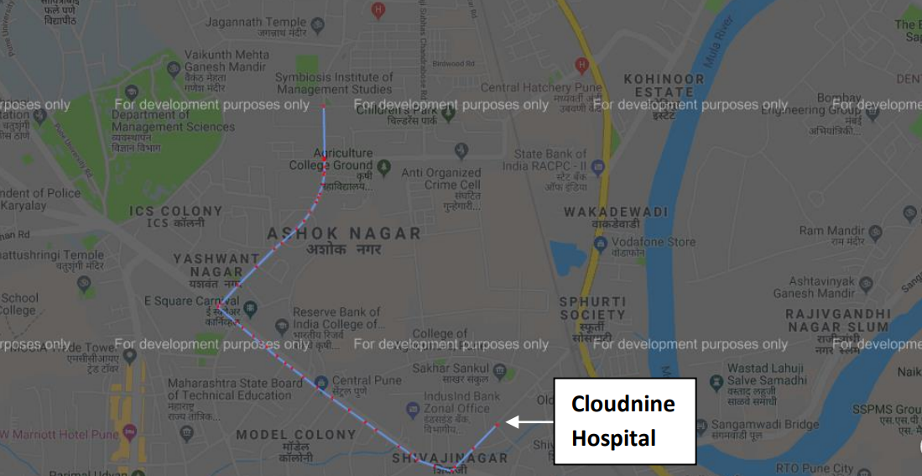
Screenshot of path and distance from Cloud nine Hospital to Symbiosis Institute of Management produced by the application using Python’s gmplot package

Slide 12
What’s new ?
Desktop application built for call centers providing emergency services.
Call center employees have no knowledge about the hospital(s) nearest to user. Application facilitates quick decision making using GIS, which is must in emergency situation.
Existing mobile apps require active internet connection for booking ambulances. The project allows users to book an ambulance just by a phone call to the call center.

Slide 13
Limitations
Weights of the edges in graph is calculated only on basis of distance b/w vertices. Real-time traffic information and condition of roads is also vital to reduce time in reaching users.
The application can only be used by the residents of Shivajinagar, Pune, since the location information in database is only restricted to Shivajinagar.

Slide 14
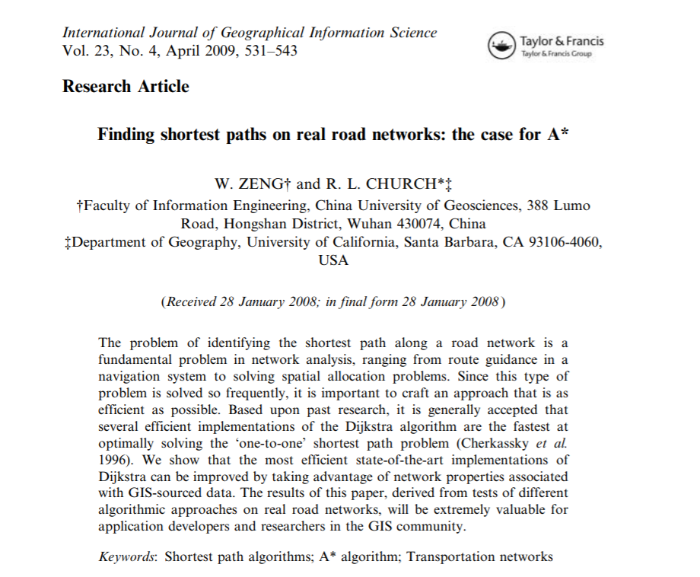
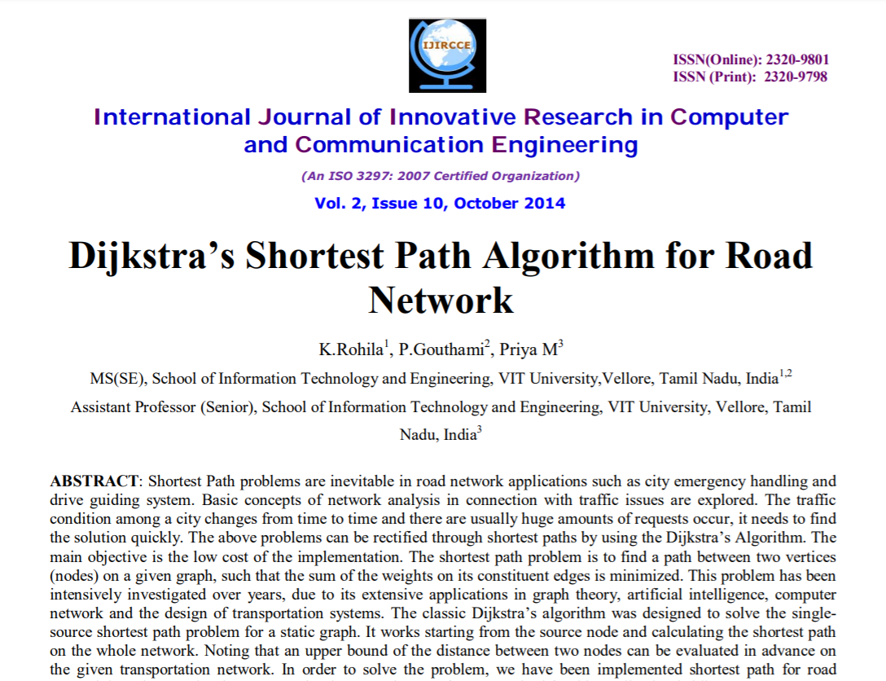
Research paper based on A* algorithm used by Google Maps and Dijkstra algorithm

Slide 15
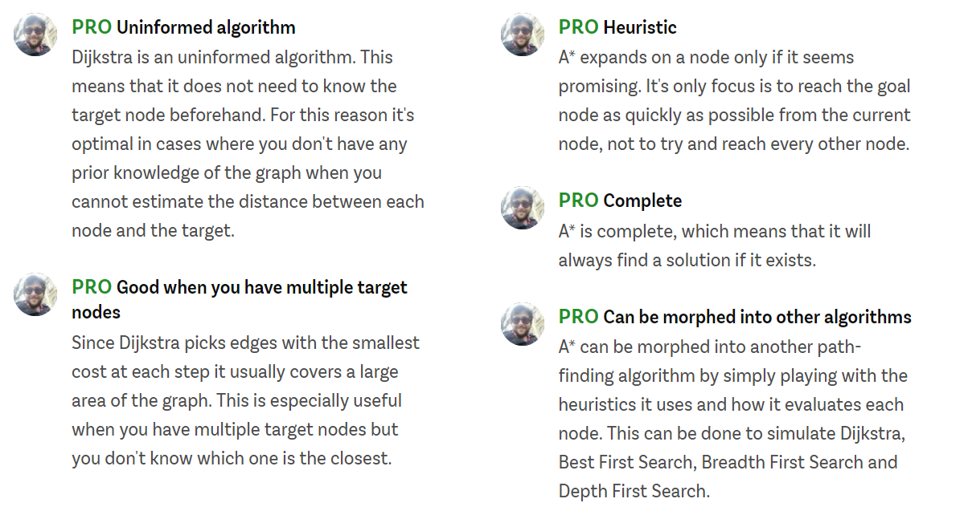
Dijkstra
A*

Slide 16
THANK YOU

